Slide 1

Graphs 2
CISC 3220 Lecture 10
By Ariel Avshalom

Slide 2
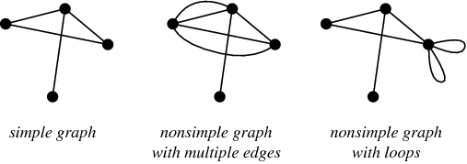
Simple labeled graphs
Simple graphs have no parallel edges (more than one edge between vertices) or self loops
Labeled graphs have symbols which represent each node
Weighted graphs have a number associated which each edge which displays the “cost” of traversing the edge

Slide 3
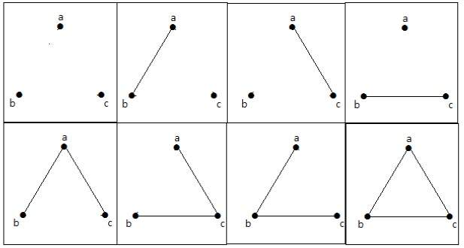

Reintroducing the power law
The number of vertices of a graph determine the number of possible graphs
Some of the graphs are isomorphic to each other, meaning they’re equivalent if you rearrange the labels
There are $2^{\left({n \atop 2}\right)}$ possible graphs with n vertices

Slide 4

Graph paths
Imagine it’s Thanksgiving Day and you’re trying to get from New York to Boston
How do you do it? Even better, how do you do it in time to see the giant turkey?
Enter graph paths and path finding algorithms!
A path on a graph is a list of k vertices where the starting node is the first vertex and the end node is the last vertex

Slide 5
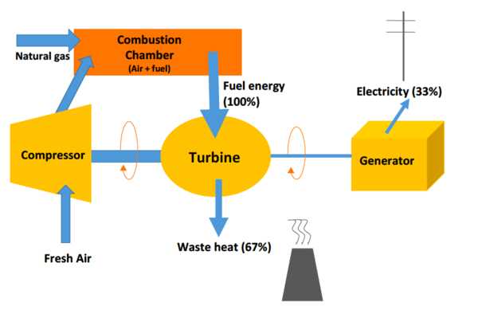
Simple cycle vs simple path
A simple path is a list of vertices where every vertex is unique
A simple cycle is similar except that the first vertex = the last vertex
Having cycles in a graph greatly change many of its properties
For instance, no tree has a cycle

Slide 6
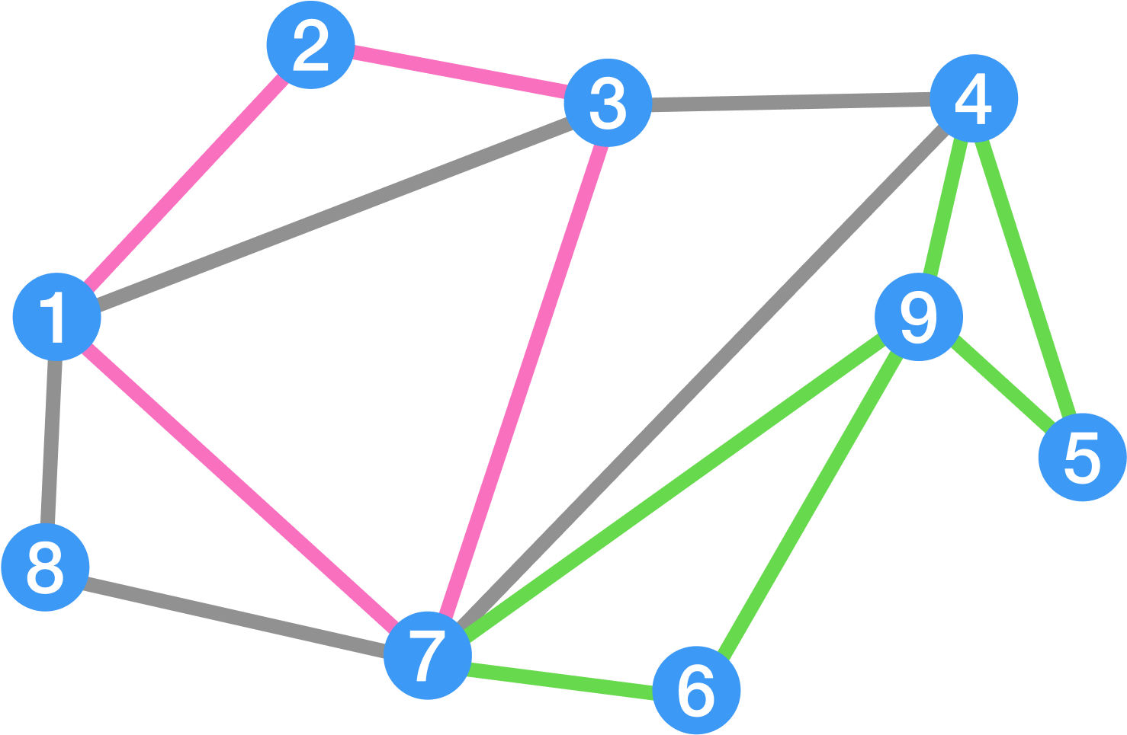
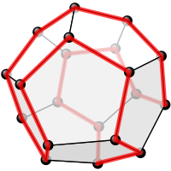
Hamilton and Euler
Leonard Euler practically invented graph theory, William Hamilton added a lot to it
Here are some graph ideas that share their names:
Euler Path: Path where all the edges of a graph are traversed
Euler Cycle: Cycle where all the edges of a graph are traversed
Hamiltonian Path: Simple path that traverses all the vertices
Hamiltonian Cycle: Simple cycle that traverses all the vertices
Spend 10 minutes going over this handy exercise

Slide 7

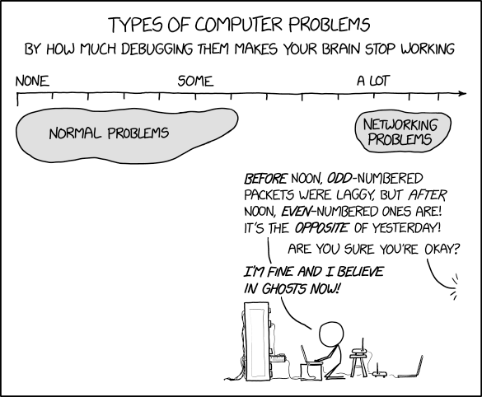
Do you have a connection?
Oftentimes, the most painful programming class is networking
You often lose the connection or suffer from packet loss
The reason you have packets is because your node (and conversely the graph) is connected
A connected graph has a path between any two pairs of nodes
A fully connected (complete) graph is a graph where every node connects to every other node

Slide 8

Assumptions
In this class unless we specify otherwise, expect a graph to be
Simple
Undirected
Unlabeled
Unweighted
Connected

Slide 9
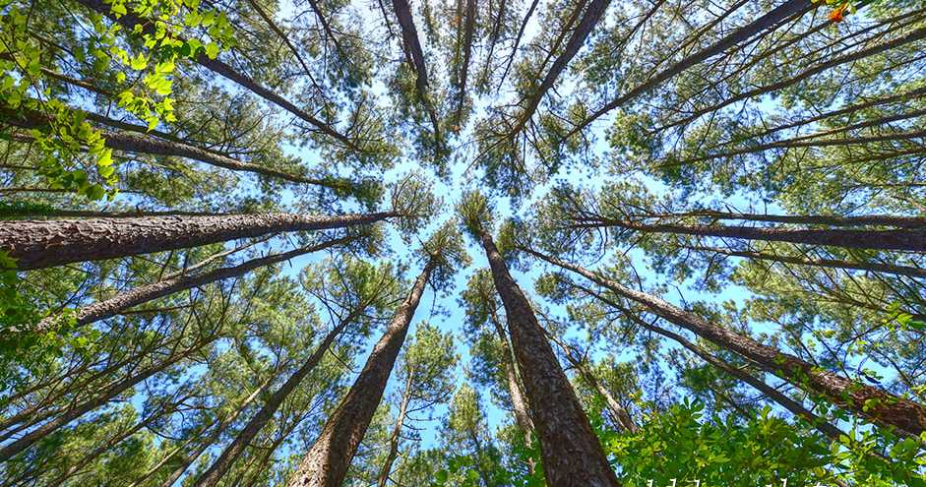
Can’t see the forest for the trees
A forest is a graph with no cycles
A tree is a connected graph with no cycles
Computer scientists are liars

Slide 10

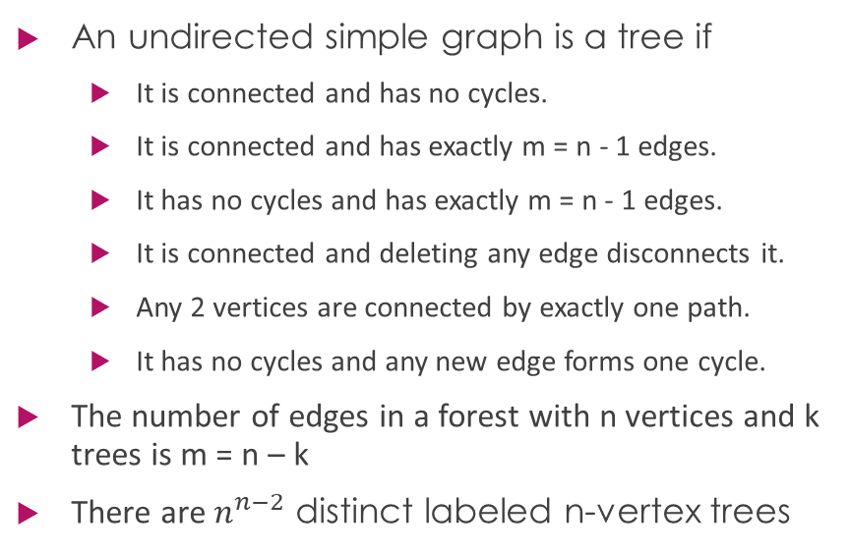
Corollaries
An undirected simple graph is a tree if
It is connected and has no cycles.
It is connected and has exactly m = n - 1 edges.
It has no cycles and has exactly m = n - 1 edges.
It is connected and deleting any edge disconnects it.
Any 2 vertices are connected by exactly one path.
It has no cycles and any new edge forms one cycle.
The number of edges in a forest with n vertices and k trees is m = n – k
There are $n^{n−2}$ distinct labeled n-vertex trees

Slide 11
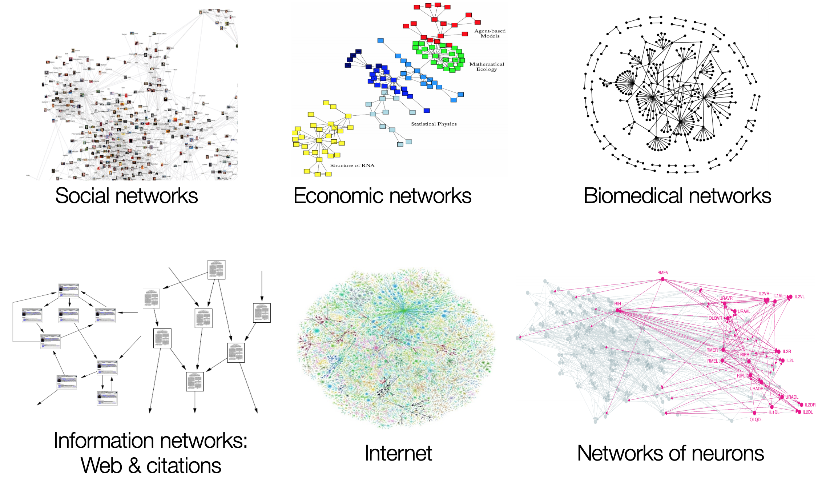
Example graphs

Slide 12
Cycles (rings), paths, stars, wheels
Ring graphs are connected graphs where all vertices have degree 2
If one edge is removed, the graph transforms into a path
Paths are trees
A star graph has one root and n – 1 leaves
A wheel is similar to a star except that all the n – 1 leaves form a cycle

Slide 13
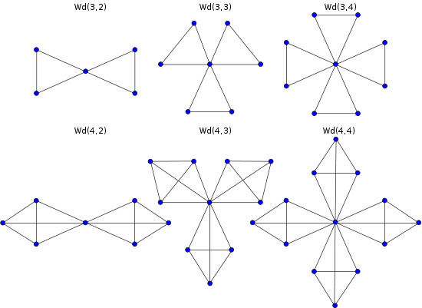
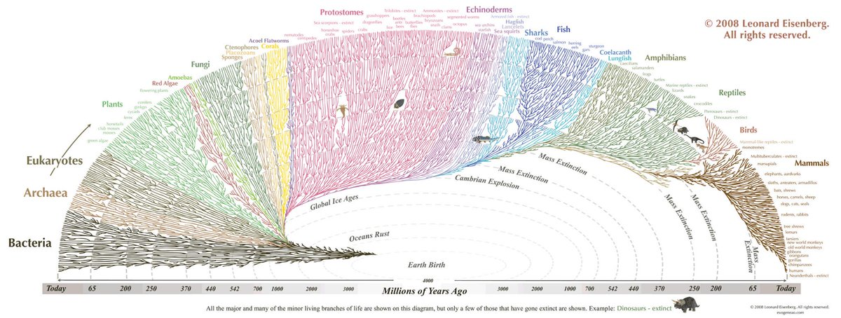

Slide 14
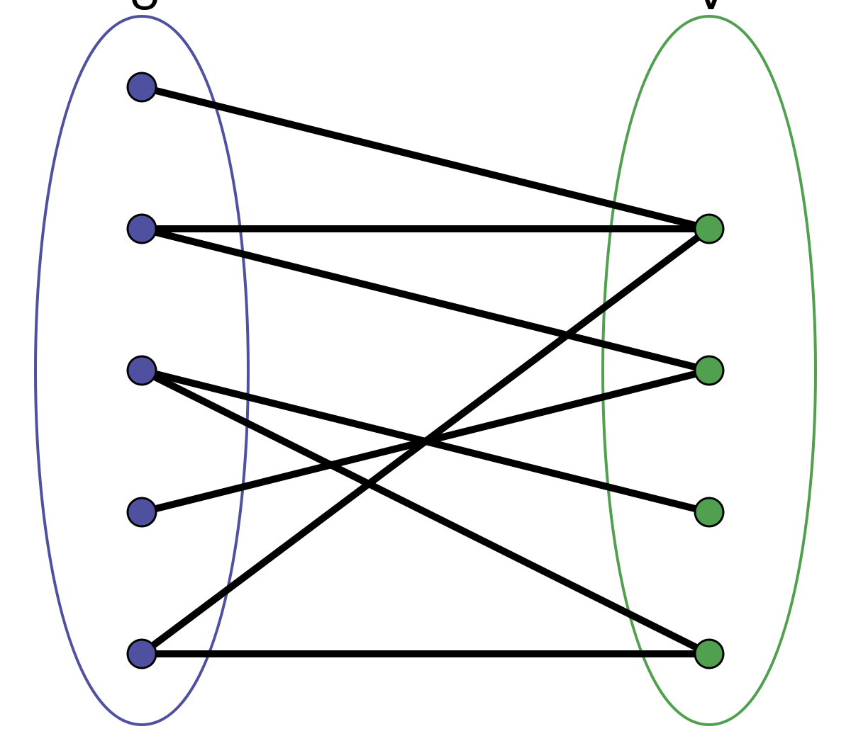
Bipartite graphs
A graph with two sets of disjoint elements where nodes in one group point to nodes in the other

Slide 15
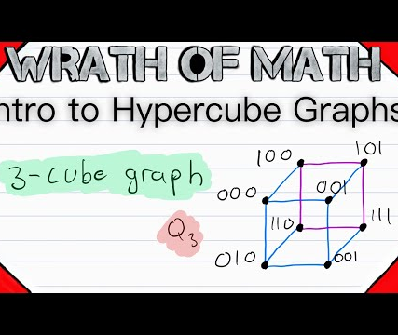


Bipartite example: enter the hypercube
There are n = $2^{k}$ vertices representing all of the $2^{k}$ binary sequences of length k
Two vertices are adjacent if their corresponding sequences differ by exactly one bit
It is used for hamming codes and error correction

Slide 16
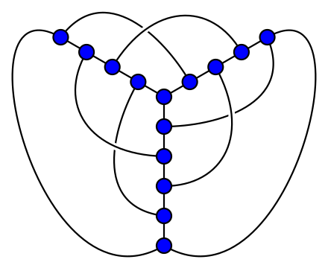
Planer graphs
Graphs that can be drawn on the plane such that edges do not cross each other
Recall maps, those are planer graphs
Every planer graph can be drawn with straight lines

Slide 17
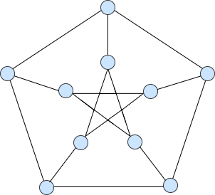
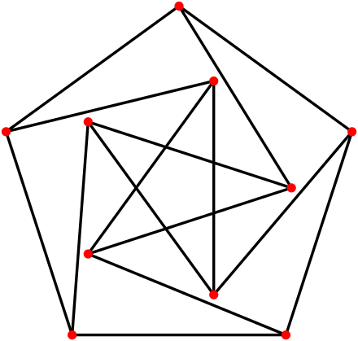


$$∆−regular graphs$$
The degree of each vertex is exactly $∆$
In $∆$-regular graphs, m = $\frac{∆∗n}{2}$
The Petersen Graph is a 3-regular graph

Slide 18
Erdos Reyni (random) graphs
Paul Erdos was a mathematical genius who passed away about a year before I was born
He was one of the most prolific mathematicians of the 20th century
Mathematicians consider an Erdos-number as cred for other mathematicians
The Erdos-number is based on how far off you are (in a graph) from a person who published a paper with Paul Erdos
Random graphs work like this (OneNote):

